Slide 1
Kubernetes + Ceph
Give your containers some storage, man!
Michele Bertasi
Team Lead TPSI team
Container Days - Hamburg 2017

Slide 2
Introduction
Bright Computing
~75 people
Bright cluster manager
Traditionally involved in HPC
Recently able to deploy Big data, OpenStack, Container orchestrators
Myself
Team lead for TPSI team
Containers, Ceph, WLM
I come from C++ development in industrial automation

Slide 3

Kubernetes

Slide 4
Kubernetes
Kubernetes is becoming de-facto standard in cloud native environments
In public cloud
In private cloud
Bare metal
How does Kubernetes manage storage?
Where do you put your storage?
Notes:
In the “server-pet” era, your DB storage was where your DB was
But now containers move around, where do you put the data?

Slide 5

The storage challenge
A container is ephemeral
The files on its disk are cleared when the container is restarted
mysql-abcde
killed
/bin/mysql
mysql:latest
/var/lib/mysql/bin.0001
run
mysql-12345
/bin/mysql

Slide 6
Introducing volumes
mysql-volume
/var/lib/mysql/bin.001
mount
mysql-abcde
killed
/bin/mysql
mysql:latest
/var/lib/mysql/bin.0001
run
mysql-12345
/bin/mysql
/var/lib/mysql/bin.0001

Slide 7
Volumes in Kubernetes
apiVersion: v1
kind: Pod
metadata:
name: test-pd
spec:
containers:
- image: gcr.io/google_containers/test-webserver
name: test-container
volumeMounts:
- mountPath: /cache
name: cache-volume
volumes:
- name: cache-volume
emptyDir: {}
The volume is specified directly in the pod definition
The lifetime is the same as the pod one
so it survives container restarts

Slide 8
Decoupling storage and compute (I)
Most of the times, cluster administrators and cluster users are different people (or teams)
Their responsibilities are different
Specifying volumes in pod definitions couple these two roles strongly
Enforcing policies by cluster admins is not possible

Slide 9
Decoupling storage and compute (II)
The solution is to separate storage requests and storage offers
Abstract details of how storage is provided from how it is consumed
Kubernetes offers two API resources for that:
PersistentVolumeClaim → request
PersistentVolume → offer

Slide 10
Cluster administrator
apiVersion: v1
kind: PersistentVolume
metadata:
name: gce-disk-1
spec:
capacity:
storage: 10Gi
accessModes:
- ReadWriteOnce
gcePersistentDisk:
fsType: ext4
pdName: gce-disk-1
A PersistentVolume maps a piece of storage in the infrastructure
The admin can create volumes of different types
They can tweak the parameters as they like
They are always in control of the allocated storage

Slide 11
Cluster user
apiVersion: v1
kind: Pod
metadata:
name: test-pd
spec:
containers:
- image: gcr.io/google_containers/test-webserver
name: test-container
volumeMounts:
- mountPath: /cache
name: cache-volume
volumes:
- name: cache-volume
persistentVolumeClaim:
claimName: task-pv-claim
apiVersion: v1
kind: PersistentVolumeClaim
metadata:
name: task-pv-claim
spec:
accessModes:
- ReadWriteOnce
resources:
requests:
storage: 3Gi
Notes:
Mapping between the Pod and the PVC
Mapping between the PVC and the PV

Slide 12
PersistentVolumes manual management
Creating volumes manually is tedious
The admin has to:
create the storage manually in their infrastructure
and the corresponding object in Kubernetes
It requires communication between users and admins every time a new volume is required
The users might need to resort to do this job themselves (no more separation of concerns)

Slide 13
StorageClass
Allows to create PersistentVolumes on demand
No more manual creation for cluster admins
Allows to expose multiple flavors, by specifying parameters to the provisioners
The users are able to choose among different options without having to know the details
A volume is then reclaimed when the PVC is gone
Various reclaim policies (retain, recycle, delete)
Default class

Slide 14
StorageClass
apiVersion: v1
kind: PersistentVolumeClaim
metadata:
name: myclaim
spec:
accessModes:
- ReadWriteOnce
resources:
requests:
storage: 8Gi
storageClassName: slow
selector:
matchLabels:
release: stable
apiVersion: storage.k8s.io/v1
kind: StorageClass
metadata:
name: slow
labels:
release: stable
provisioner: kubernetes.io/aws-ebs
parameters:
type: gp2

Slide 15
Going on-premise
The previous example involved public cloud
If on-premise
we need to setup our own storage
we need to expose it to Kubernetes
Multiple possibilities, but we need:
Distributed storage
Reliable
(at minimum)

Slide 16

Ceph

Slide 17
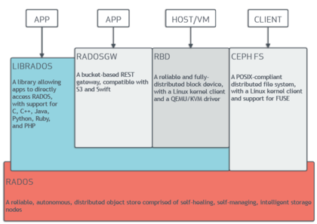
What is Ceph?
Notes:
It’s a software defined storage solution
It’s an object store at the bottom, but it provides block and file storage (CephFS)
Hardware agnostic (more or less)
Based on RADOS
Reliable
Autonomous
Distributed
Scalable

Slide 18
Ceph nodes
OSD nodes
store the data
multiple OSD daemons per node
Monitor nodes
keep track of the state of the cluster
allow clients to retrieve the cluster map
Optional metadata servers
file storage for CephFS

Slide 19
Ceph data placement
Client
A client writes an object to a pool
CRUSH assigns the object to a PG
CRUSH assigns the PG to an OSD
The primary OSD replicates the PG to the secondary OSDs
1
Pool
Pool
Pool
2
PG
PG
PG
PG
PG
3
OSD
OSD
OSD
OSD
OSD
4
Notes:
In Ceph, every abstraction is built from the object storage (Block storage, File System, S3 buckets).
Objects belong to pools, and pool are made out of placement groups. Each placement group maps to a list of OSDs.
The pool is the way Ceph divides the global storage. Each pool defines its own set of rules (like replicas, and ownership).
The placement group is the abstraction used by Ceph to dynamically map objects to OSDs.
In Ceph each object is stored in a pool, so pool and object name uniquely identify the object in the system
By hashing these two values together, the CRUSH algorithm computes a PG.
Ceph uses the PG along with the cluster map and the placement rules to get the list of OSDs.
The first one returned is the primary one, and it’s the one used by the client to write their data.
The primary OSD is then responsible to replicate the data to the secondary OSDs. This number depends on the settings of the pool.

Slide 20
Setup Ceph for Kubernetes
We have to create a pool
A logical group for storing objects
A pool has its own set of parameters
Authentications
An admin auth, able to create images in the pool
A client auth, able to write the images

Slide 21
Ceph RBD storage class
apiVersion: storage.k8s.io/v1
kind: StorageClass
metadata:
name: fast
provisioner: kubernetes.io/rbd
parameters:
monitors: 10.16.153.105:6789
adminId: kube
adminSecretName: ceph-secret
adminSecretNamespace: kube-system
pool: kube
userId: kube
userSecretName: ceph-secret-user
kubectl create secret generic \
ceph-secret --type=kubernetes.io/rbd \
--from-literal-key=’<key>’ \
--namespace=kube-system
We need
One admin secret
User secrets (one per namespace)

Slide 22
Demo

Slide 23
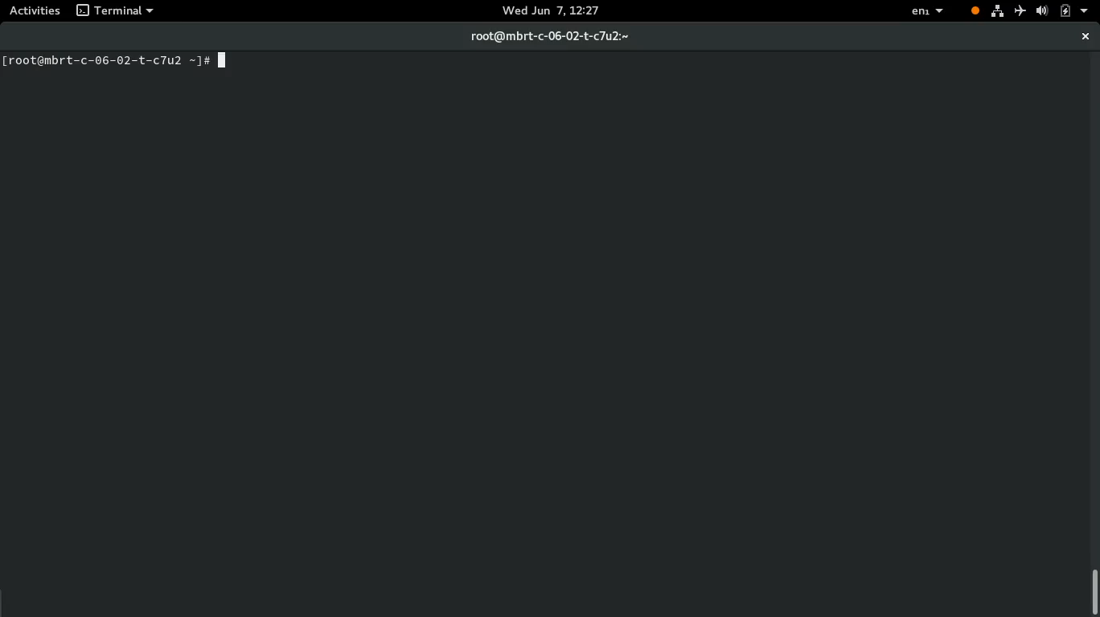

Slide 24
Conclusion
Kubernetes is able to manage containers and storage resources of a cluster automatically
Separation of concerns between cluster administrators and cluster users with StorageClass, PersistentVolumeClaim.
Cluster admins can tweak the storage parameters
Cluster users can ask for storage without to know the details
Ceph provides a distributed, reliable storage for Kubernetes
Production ready
You can reuse it for other purposes, like OpenStack

Slide 25
References
Demo files in my GitHub: https://github.com/mbrt/kube-ceph-demo
Ceph
http://docs.ceph.com/docs/master/rados/operations/pools/
http://docs.ceph.com/docs/master/start/hardware-recommendations/
Kubernetes
https://kubernetes.io/docs/concepts/storage/persistent-volumes/

